Slide 1

Understanding The People’s Budget
The People’s Budget Campaign American Friends Service Committee
Campaign for America’s Future
Coalition on Human Needs
Daily Kos
Friends of the Earth
National Alliance of HUD Tenants
National Priorities Project
NETWORK Lobby
Peace Action
People Demanding Action
Progressive Congress
Progressive Democrats of America
Social Security Works
Social Solutions
US Labor Against the War
Win Without War

Slide 2


Introduction and Welcome
Andrea Miller, Executive Director
People Demanding Action
andrea@peopledemandingaction.org
Call Structure and Norms:
Audio is PHONE ONLY; you must call in
Do not enable your video camera
All calls are recorded; a link is available after the call
Q & A mode: To eliminate background noise we mute everyone when we begin recording.
Press *6 (when prompted) to ask a question; say your name, your organization, if any, and location. Be courteous and brief; give others a chance to ask questions too.
Download this Presentation: https://actionnetwork.org/campaigns/the-peoples-budget-campaign

Slide 3
Speakers
Michael Darner, Executive Director, Congressional Progressive Caucus
Alicia Molt, Office of Rep. Mark Pocan
Cole Harrison, Peace Action
Michael Kane, National Alliance of HUD Tenants
H. Demetrius Bonner, National Alliance of HUD Tenants
Russell Greene, People Demanding Action
Paul Shannon, American Friends Service Committee

Slide 4


Technical Information
Audio is available only via phone
DIAL IN: 605 562 3140 ACCESS CODE: 781761#
Meeting Room Functions
- Chat
- Share
Use the Share button in the Meeting Room:
After the call, click the unique link below to download this week's PowerPoint, recording link and other materials: http://www.peopledemandingaction.org/campaigns/the-people-s-budget

Slide 5
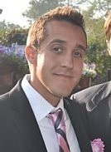
Michael Darner
Mike Darner serves as the Executive Director of the Congressional Progressive Caucus. The CPC consists of one United States Senator and 70 members of the United States House of Representatives, and is the largest caucus within the House Democratic Caucus. Established in 1991, the CPC reflects the diversity and strength of the American people and seeks to give voice to the needs and aspirations of all Americans to build a more just and humane society. Prior to joining the CPC, Mike served as Legislative Director for Congressman John Conyers, Jr. (D-MI) for six years. He has also worked as an attorney specializing in election law. He is an alumnus of Miami University and the Catholic University of America’s Columbus School of Law.

Slide 6
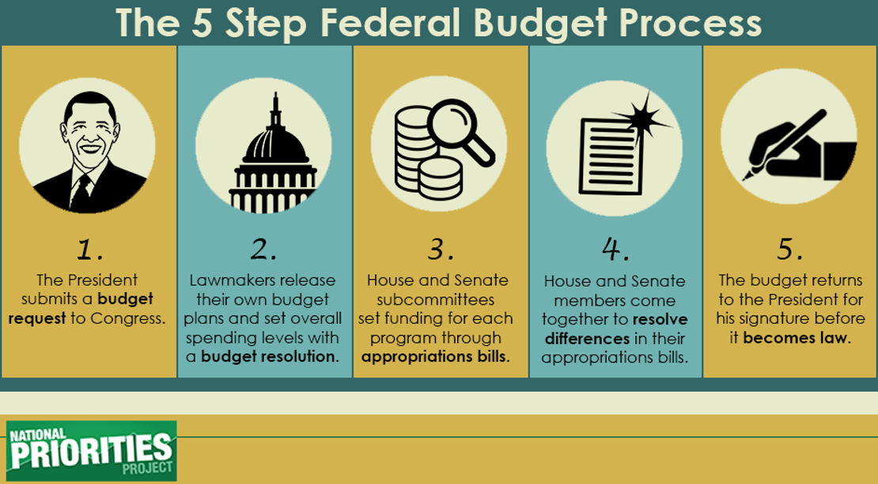
The 5 Step Federal Budget Process

Slide 7
Overview of The People’s Budget
Provide a $1 trillion investment to repair roads and bridges and ensure our crumbling infrastructure is restored. This includes a down payment of $150 billion, and $765 million specifically for Flint, Michigan, to update aging water drinking pipes in the most vulnerable communities.
Access to equitable education opportunities is key to ensuring future generations are prepared for success. From pre-school through college, every student deserves the right to high-quality affordable education. The People’s Budget invests in our students by providing robust early learning opportunities, effective public schools for all students, and debt-free college.

Slide 8
Overview of The People’s Budget
The People’s Budget creates 3.6 million good paying jobs to push our economy back to full-employment, which will provide the necessary economic conditions to spur across-the-board wage growth for hardworking Americans
It empowers working families, protects collective bargaining, and seeks to close the pay equity gap
It increases funding for worker protection agencies to crack down on wage theft, combat overtime abuses, and safeguard workers’ retirement savings

Slide 9
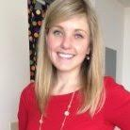
Alicia Molt
Alicia Molt has worked on Capitol Hill for 6 years and is Congressman Mark Pocan’s Legislative Director and Deputy Chief of Staff. Prior to working for Rep. Pocan, she worked for Congressman Jim McGovern from Massachusetts and Congresswoman Gwen Moore from Milwaukee, Wisconsin. Alicia is originally from Worcester, Massachusetts is a graduate of Holy Cross College and Johns Hopkins University.

Slide 10
Invest in America
Invests $1 trillion to transition to 21st Century infrastructure, which ensures our roads, bridges, railways, and facilities are strong and that no town experiences the devastating effects of crumbling infrastructure we’ve seen in Flint, Michigan
Delivers on the promise of effective early childhood education by fully funding Early Head Start
Makes debt free college a reality for all students
Expands commitment to create efficient renewable energy and competitive, high-quality green jobs

Slide 11
Pathways Out of Poverty and Empowering the Middle Class
Supports wage increases for working Americans, negotiating rights and fair pay
Provides a plan to reduce poverty by half in ten years
Increases discretionary funding to invest in women, communities of color and their families
Reverses harmful cuts and enhances the social safety net
Provides an increase in Trade Adjustment Assistance for workers displaced by bad trade deals

Slide 12
Justice and Fair Elections
Supports a justice system that is fair and effective for all Americans with full funding for key DOJ programs, including public defenders and recidivism reduction
Rebuilds trust in the justice system by funding community oriented policing reforms
Strengthens Department of Justice Voter Protection Programs
Protects voting rights by increasing funding to voter protection agencies
Funds public financing of campaigns to curb the influence of special interests in politics

Slide 13
Fair Individual Taxes
Ensures profits from investments are taxed at the same rate as income from work
Returns to Clinton-era tax rates for households making over $250,000 and implements new brackets for those making over $1 million
Expands the Earned Income Tax Credit and the Child Care Credit

Slide 14
Fair Corporate Taxes
Eliminates the ability of U.S. corporations to defer taxes on offshore profits
Ends corporate inversions that allow U.S. companies to avoid paying taxes
Enacts a Financial Transaction Tax on Wall Street’s high-stakes trading
Ends unlimited executive pay tax write-offs

Slide 15
Educational Opportunities for Every Student
Fully funds Individuals with Disabilities Education Act (IDEA) and provides Pre-K for all
Greater investments in K-12 education
Increases computer science opportunities for all students
Provides for the refinancing of student loans

Slide 16
Affordable Health Care
Repeals excise tax on high-priced healthcare plans for workers and replaces it with a public option
Implements drug price negotiation for Medicare
Allows states to transition to single-payer health care systems
Expands access to mental health care and treatments for opioid and heroin addiction

Slide 17
Protect our Environment
Closes tax loopholes and ends subsidies provided to oil, gas, and coal companies
Implements a price on carbon pollution
Invests in clean, renewable, and efficient energy and green manufacturing

Slide 18
Sustainable Defense: Promoting peace And Security
Modernizes our defense system to create sustainable Pentagon spending
Ends funding for unsustainable wars
Increases funding for diplomacy and strategic humanitarian aid
Adds robust funding for refugee resettlement programs

Slide 19
Access to Housing
Fully funds programs to make housing affordable and accessible for all Americans
Addresses the pervasive and persistent problem of poverty in America through an $11 billion investment to end family homelessness

Slide 20
Strengthening our Commitment to Veterans
Increases funding for veterans supportive housing to eliminate veterans homelessness
Expands access to mental health care for all veteran and service members
Invests in job training opportunities for transitioning service members and veterans

Slide 21
Immigration and Small Business
Fully funds the Small Business Administration’s loan programs to help America’s small businesses remain competitive and continue to grow
Implements comprehensive immigration reform, including a pathway to citizenship

Slide 22
Q&A – Mike Darner and Alicia Molt

Slide 23
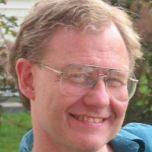

Cole Harrison
Cole Harrison Move the Money coordinator for Peace Action. He is also Executive Director of Massachusetts Peace Action. He is on the coordinating committee of Budget for All Massachusetts campaign, and co-coordinates the People's Budget Campaign.

Slide 24
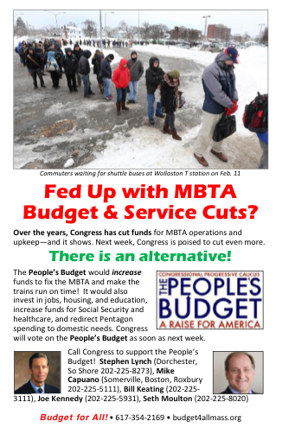
Budget Issues Are Grassroots Issues
The People's Budget connects multiple progressive constituencies
It received 96 votes in 2015 yet is not taken seriously by the media - so we have to organize our own campaign
We need to break down the budget and bring it to the grassroots
We need to campaign on the PB all year around

Slide 25

What was in the People's Budget for FY2016
Create Jobs
Meet people’s needs through services
Fair Taxes
Reduce Military Spending
Combat Climate Change

Slide 26
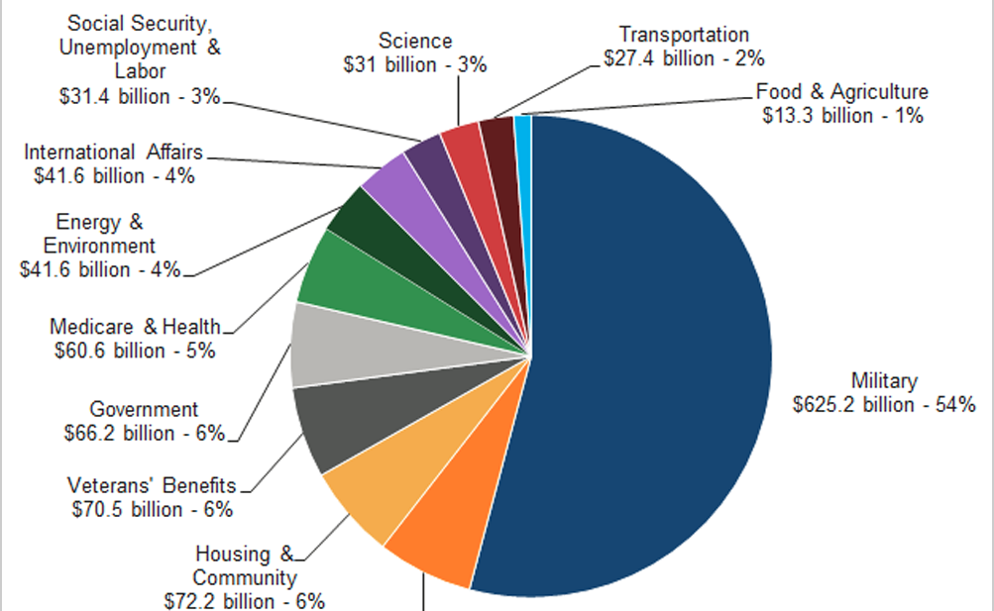
Fleshing out the People's Budget for FY2017
$1.15 Trillion Discretionary Spending
Housing
Public transit
Climate
Military
Nuclear weapons

Slide 27
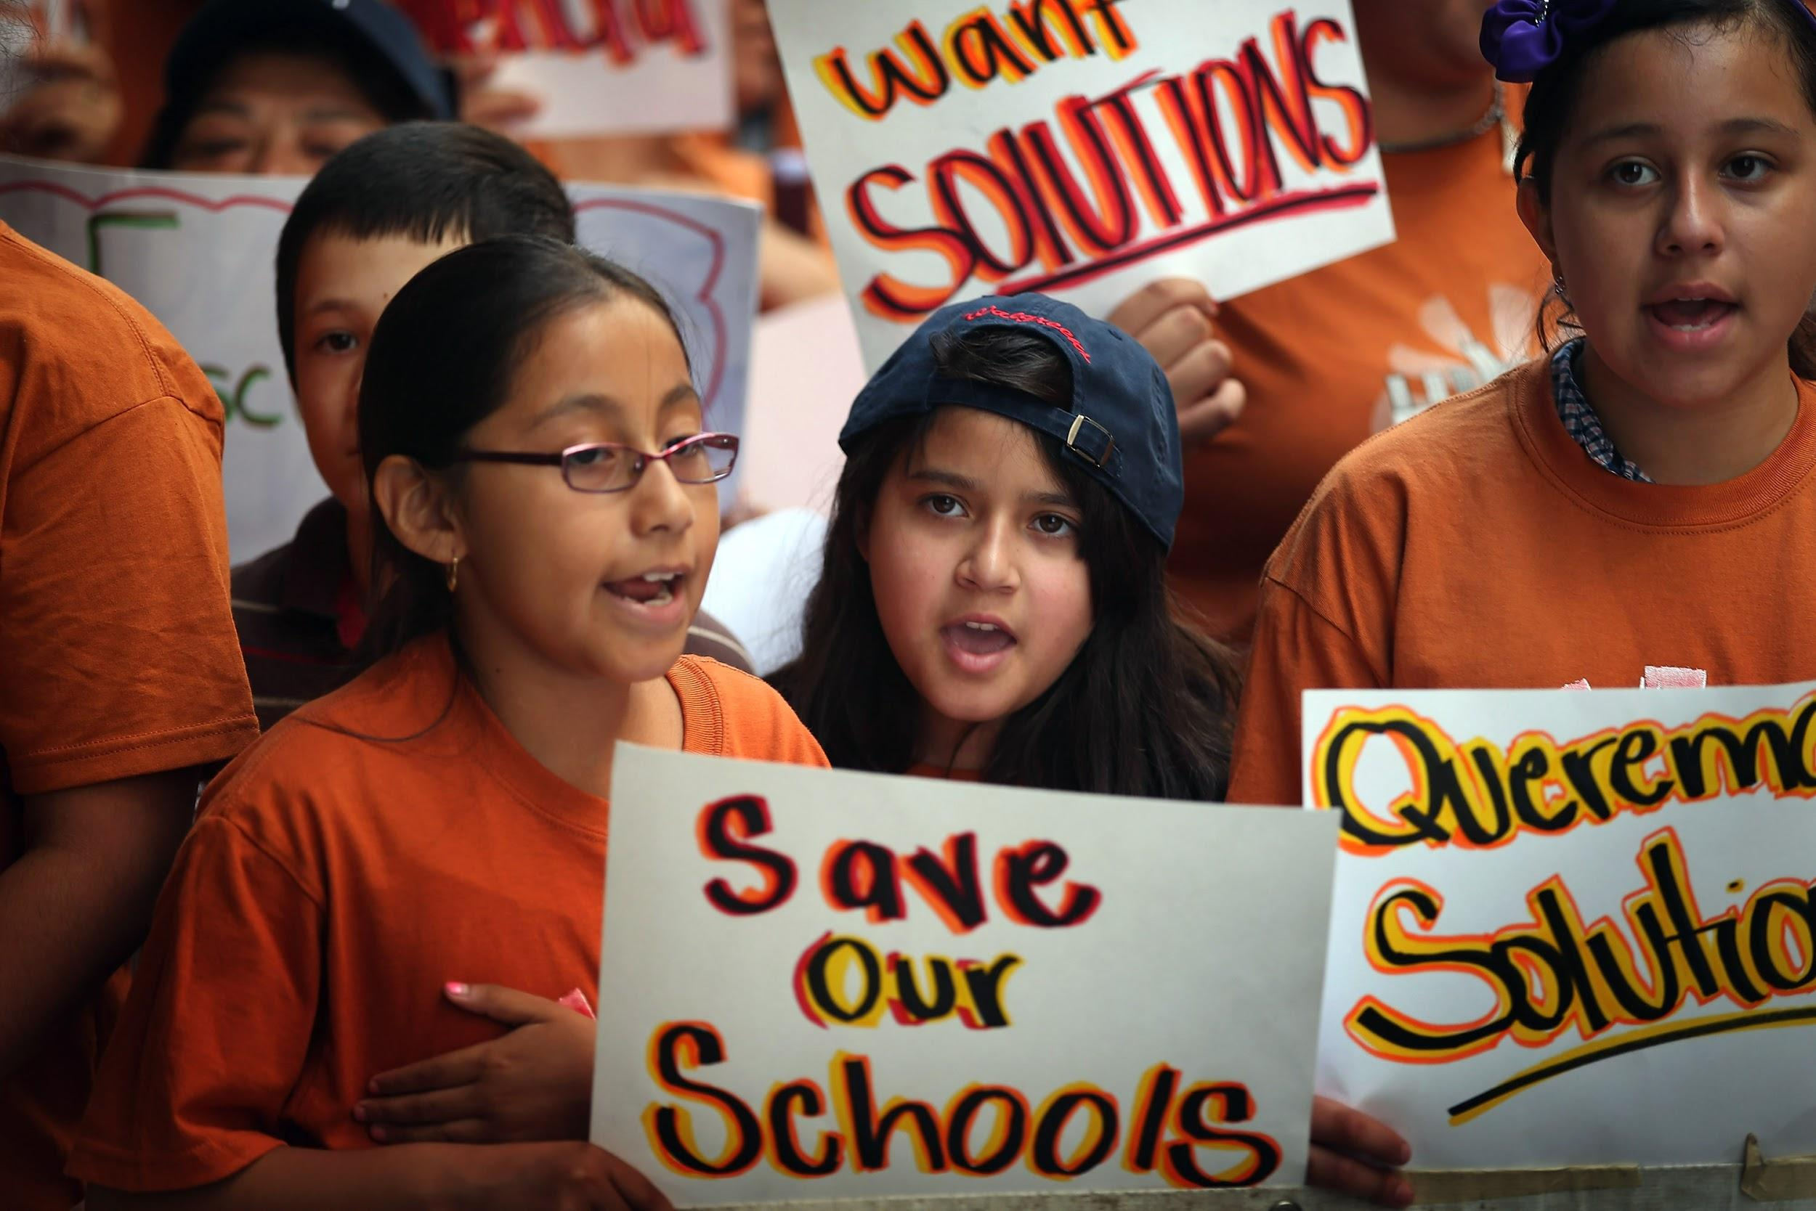
Continuous lowering of standards of living for the U.S. majority
In the years to come the Republican Congress will continue to cut appropriations for:
Housing
Healthcare
Food stamps
Clean water
Education
We need to identify the victims of these cuts as our constituencies!

Slide 28
Why a People's Budget Campaign?
Activate the progressive grassroots on a comprehensive cross-issue platform
Link the PB to campaigns over component issues (for ex, debt-free college; climate change; military appropriations; shutdown threat)
Build bridges between social justice movements, promote cross-movement solidarity and collaboration
Make the PB a serious "player" each year; Increase Congressional support for the PB in annual vote

Slide 29
How to organize for the People's Budget
Bring together more national organizations in the People's Budget Campaign
Subject matter is complicated: Communication and research resources are important
Online campaigning: Link the People’s Budget to topical issues throughout the year
Move more progressive Democrats to support the budget who have not yet done so
  Target gettable reps who can be moved
  Build a local coalition to campaign for the member's attention
  Link federal budget issues with locally resonant issues in those districts

Slide 30
Coordination between CPC & Grassroots Advocates
Keep the “People’s Budget” brand for several years so that we have time to build recognition
  Use a subtitle to differentiate each year
Identify areas for substantive change well in advance (fall?)
Release budget preview in advance and share with advocates to prepare campaigns
Tie PB to topical issues during the year and coordinate those plans

Slide 31
Next steps
Join us for our Workshop & Breakout
Website peopledemandingaction.org/campaigns/the-people-s-budget
Handouts on proposed improvements to PB
Timeline for this year’s budget cycle
  Feb 9: President’s Budget released by OMB
  Feb 25: House Budget committee markup budget resolution
  week of Feb 29: House floor action on budget
  March 15th: People’s Budget Press Conference

Slide 32
Can You Visit/Call These Reps?
Rep. Eric Swalwell(CA15)
Rep. Julia Brownley (CA26)
Rep. Brad Sherman (CA30)
Rep. Rosa DeLauro (CT03)
Rep. John Larson (CT01)
Rep. Stanford Bishop (GA02)
Rep. Tulsi Gabbard (HI02)
Rep. Tammy Duckworth (IL08)
Rep. Joseph Kennedy (MA04)
Rep. Dutch Ruppersberger (MD02)
Rep. Steny Hoyer (MD05)
Rep. Chris Van Hollen (MD08)
Rep. Bill Pascrell (NJ09)
Rep. Steve Israel (NY03)
Matt Cartwright (PA17)
Rep. Jim Langevin (RI02)
Rep. Beto O’Rourke (TX16)
Rep. Joaquin Castro (TX20)

Slide 33
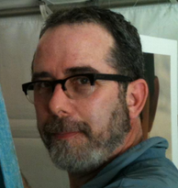
Russell Greene
Russell Greene has been focused on the climate crisis since 1988. He is President, People Demanding Action, Founder and Chair, Progressive Democrats of San Fernando Valley, Chair, PDA, Stop Global Warming Issue Team, Advisory Board Chair, Kids vs. Global Warming, iMatter and Leader Corps, Climate Reality Project.

Slide 34
Protecting Our Environment
“The only budget in Washington that truly accepts the urgency of the climate crisis.” Lukas Ross, Friends of the Earth
Impose a Price on Carbon Pollution
Eliminate Corporate Welfare for Oil, Gas and Coal Companies
Helping Communities Adapt
Reinstate Superfund Taxes
Crop Insurance Subsidies

Slide 35

Impose a Price on Carbon Pollution
The People’s Budget implements a $25 per ton price on carbon dioxide emitted by polluters (increasing at 5.6 percent a year) and rebates 25 percent of all revenues to protect low income families from any rising energy costs via refundable credits. Revenue from this carbon price will be used to fund renewable energy and energy efficiency development and deployment. The Energy Information Administration found that a similar proposal would result in carbon emissions reductions of 26 percent below 2005 levels by 2020. This will go a long way toward setting the United States on a path to minimize the dangers of climate change, particularly when combined with air pollution control measures, increased energy efficiency and renewable energy deployment.

Slide 36
Eliminate Corporate Welfare for Oil, Gas and Coal Companies
The CPC Budget repeals approximately $135 billion in fossil fuel subsidies over 10 years. The fossil fuel industry enjoys dozens of permanent subsidies thanks to decades of successful lobbying. Just one of these loopholes, the “percentage depletion allowance,” will cost taxpayers $17 billion over the next decade. Researchers at the International Monetary Fund found that in 2015 fossil fuel subsidies (including both tax breaks and the cost of health and environmental externalities) cost $5.3 trillion – or $10 million a minute.

Slide 37
Helping Communities Adapt
The People’s Budget increases funding for EPA climate adaptation programs and FEMA climate resiliency initiatives. It also incorporates the job training and economic development funding outlined in the President’s POWER plus plan to assist displaced fossil fuel workers and communities impacted by changing energy policies.

Slide 38
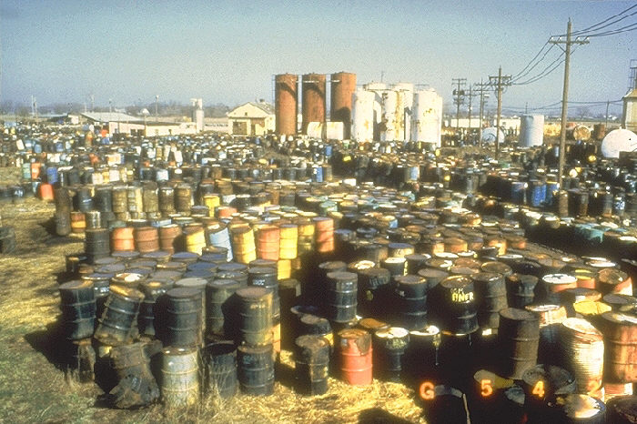
Reinstate Superfund Taxes
Our budget reinstates the Superfund excise taxes that expired in 1995. The Environmental Protection Agency’s Superfund program, once largely funded by dedicated taxes, is now funded primarily by general revenue. Having a stable source of funding, rather than relying on year-to-year appropriations, will provide $22 billion more for cleanup of hazardous and contaminated land, often located in disadvantaged communities.

Slide 39

Crop Insurance Subsidies
The CPC Budget reduces the federal government’s subsidy from 60 percent to 40 percent premiums, on average. Insurance policies purchased through the program are sold and serviced by private insurance companies, which are reimbursed by the federal government. In 2013 the Congressional Budget Office predicted that crop insurance will cost taxpayers about $90 billion over the course of a decade.

Slide 40
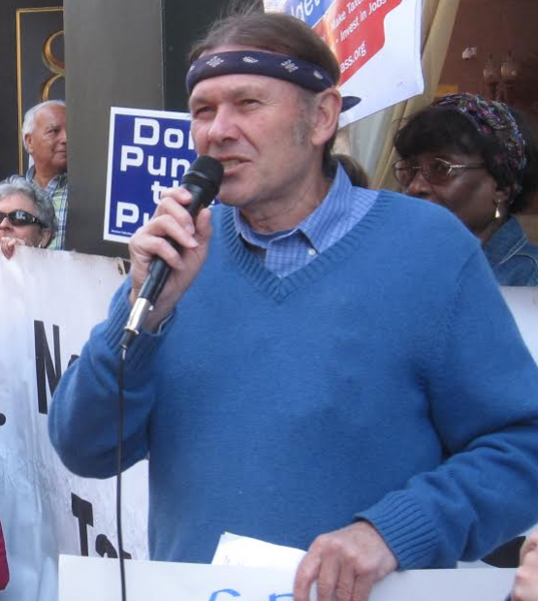

Paul Shannon
Paul Shannon is on the staff of the American Friends Service Committee in Cambridge, Massachusetts and a Coordinator of the Massachusetts Budget for All Coalition

Slide 41
Military spending in the Peoples Budget
The Peoples Budget makes far deeper and more significant cuts in Pentagon spending than any other budget
Its strongest feature is that it cuts $761 Billion from the Overseas Contingent Operations (OCO) war slush fund over the next 10 years while also funding the orderly and safe withdrawal of the thousands of U.S. ground troops now in Afghanistan
The OCO account has been used to fund numerous American wars which have helped turn the Middle East and South Asia into a seething cauldron of suffering and death: Iraq, Afghanistan, Pakistan, Libya, Syria, Somalia, Yemen and now in Iraq again

Slide 42
Military spending in the Peoples Budget
The Peoples’ Budget also provides significant funding for middle east refugee re-settlement programs, diplomacy, and humanitarian assistance to war shattered areas
It also provides for cuts in Pentagon base budget
  Establishing a “responsible approach” toward a sustainable defense budget
  Reducing the use of private contractors that has led to big cost-overruns
  The de-commissioning of cold war era nuclear weapons
  Reducing procurement and R&D my making “smarter” procurement choices
  Creating a “leaner” military with fewer military personnel which is focused on modern security threats instead of cold war weapons and contracts
  Auditing the Pentagon

Slide 43
Why the Peace Movement Should Support The People’s Budget
We should support of the Peoples’ Budget for 2 reasons:
First, its Pentagon cuts are larger and more significant in terms of stopping wars than in any other budget proposal. Pentagon cuts is the most difficult section of the People’s Budget for CPC members to “sell” to other members of Congress and even to CPC members. If we in the peace movement want deeper cuts, it is up to us to create the conditions that make deeper cuts politically feasible
This CPC budget can serve as a vehicle that allows us to work on a common project with climate, social and racial justice movements who should be attracted to its bold increases in funding for all the programs the country needs

Slide 44
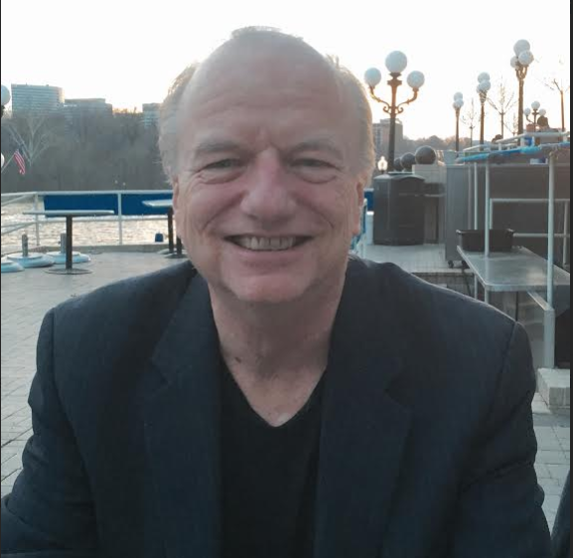
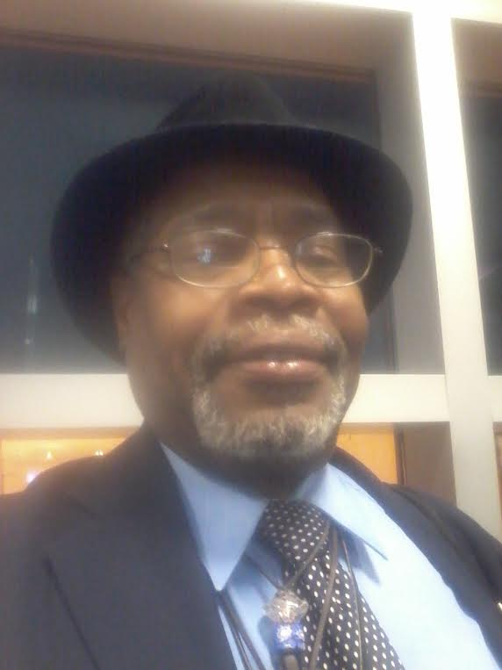
National Alliance of HUD Tenants
Michael Kane has served as the Executive Director of the National Alliance of HUD Tenants since 1994. NAHT is the national union representing the 1.7 million tenants in privately-owned, HUD subsidized multifamily housing, and is the only national tenants union in the US. Kane has also organized HUD tenants in Massachusetts with the Mass Alliance of HUD Tenants since 1983, helping tenants save 12,200 apartments as affordable housing, one building at a time, through tenant organizing. Kane also served on the Board of the Habitat International Coalition (HIC), the leading global housing rights network, from 2004 through 2014, including a term as Vice President.
H. Demetrius Bonner, Vice-President: North Drexel Court Tenant Association Chicago, IL

Slide 45
Affordable Housing
Expand affordable housing through increased CDBG and HOME funding
Provides resources for Public, Elderly and Disabled Housing
Restores 70,000 Section 8 Vouchers
Provides new Vouchers to reduce wait lists

Slide 46
Affordable Housing
Funds 25,000 new supportive and 8,000 rapid rehousing units for the homeless
Supports President Obama’s $11 billion request to end family homeless by 2020
Provides robust funding for Low Income Heating Assistance

Slide 47
Q&A – Endorsing Organizations
American Friends Service Committee
Peace Action
National Alliance of HUD Tenants
People Demanding Action

Slide 48
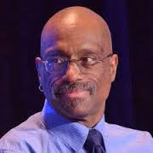

Isaiah Poole
Isaiah J. Poole has been the editor of OurFuture.org since 2007. Previously he worked for 25 years in mainstream media, most recently at Congressional Quarterly, where he covered congressional leadership and tracked major bills through Congress.
Most of his journalism experience has been in Washington as both a reporter and an editor on topics ranging from presidential politics to pop culture. His work has put him at the front lines of ideological battles between progressives and conservatives. He also served as a founding member of the Washington Association of Black Journalists and the National Lesbian and Gay Journalists Association.

Slide 49
Blog Posts on The People’s Budget
Flint, MI Water Crisis Is Proof Positive That We Need Better Infrastructure and a Progressive Budget By Olivia Alperstein, Progressive Congress and Jonathan Alan King, Massachusetts Budget for All Campaign
Investing in People Matters: A Black Man’s perspective on The People’s Budget by Marc Carr, Social Solutions
Why we need the People's Budget and its $1 trillion infrastructure jobs plan by Isaiah Poole, Campaign for America’s Future
The Peoples’ Budget and Pentagon Spending: A Start in the Right Direction by Paul Shannon, American Friends Service Committee

Slide 50
Blog Posts on The People’s Budget
The People’s Budget is the Greenest Option in Washington by Lukas Ross, Friends of the Earth
Five Reasons to Support The People’s Budget by National Priorities Project
The Pro-Social Security Congressional Progressive Caucus Budget by Nancy Altman, Social Security Works
The People’s Budget: Pushing Us Toward a Peace Economy by Miriam Pemberton, Institute for Policy Studies

Slide 51
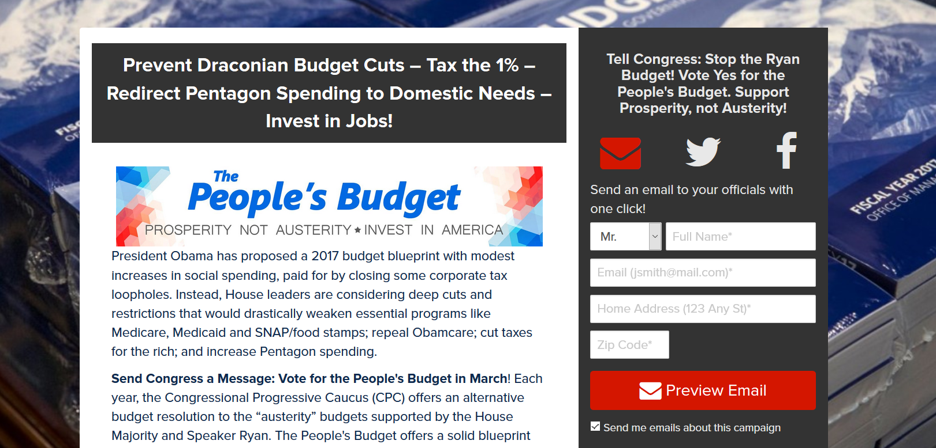
Next Steps - Working with Congress
Email your House Member and ask them to support The People’s Budget
  We have sent more than 5,300 emails to House members
  We need to send more than 30,000 emails

Slide 52
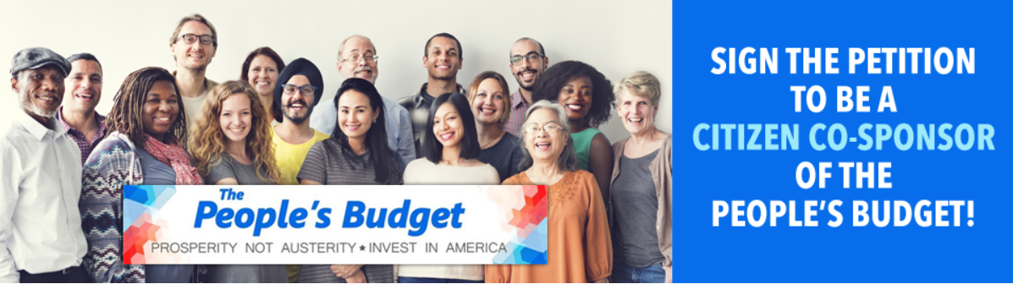
Working with Congress
Participate in the Daily Kos Mega-Petition
  22 participating organizations
  Sign the petition to become a Citizen Cosponsor of The People’s Budget
  Our goal is to get more than 125,000 signatures

Slide 53
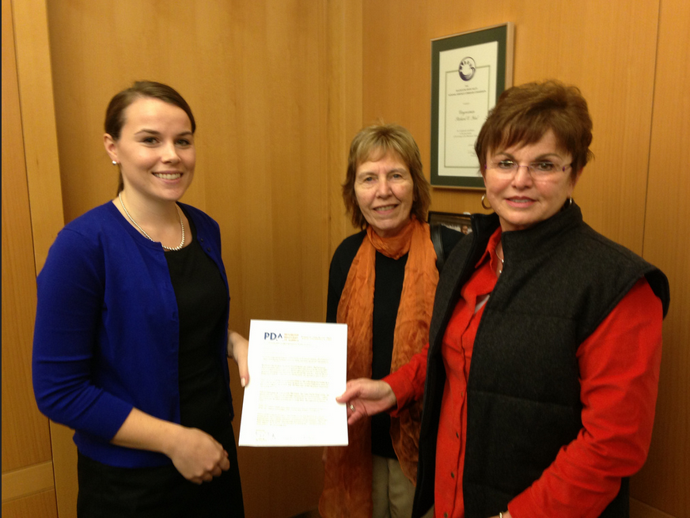
Working with Congress
Deliver a letter to your House Member asking them to support The People’s FY 2017 Budget
https://actionnetwork.org/event_campaigns/building-congressional-support-for-the-peoples-budget

Slide 54
Informing Your Community
Write a Letter to the Editor
Share our Blog Posts
  Daily Kos
  Huffington Post
  Common Dreams
Host a Town Hall Meeting (for FY2018 People’s Budget) – Summer
Find Resources at: http://www.peopledemandingaction.org/campaigns/the-people-s-budget

