Slide 1
National TPP Call
Intellectual Property
August 23, 2015
7:30 PM Eastern/ 4:30 PM Pacific
Call In: 605-562-3140 PIN: 951146#
Backup: 559-726-1300

Slide 2

Introduction and Welcome
Andrea Miller
Executive Director,
People Demanding Action
Call Norms
Meeting Room Functions
Website: www.peopledemandingaction.org
andrea@peopledemandingaction.org

Slide 3
Technical Stuff
DIAL IN : 605 562 3140 Pin 951146#
VIEW THE WEBINARhttp://login.meetcheap.com/conference,87610294
JOIN THE CHAT
DOWNLOAD THE POWERPOINT: www.peopledemandingaction.org/downloads/tpp

Slide 4

Call Host Team
Tom Hocking
Technical Advisor
Call Planning Team
MoveOn Regional Organizer (PA)
Pre/Post Call Technical Questions
Global TPP Team Facebook Page Manager
Facebook
https://www.facebook.com/groups/GlobalTPPTeam

Slide 5

Planning/Notes
Liz Amsden
Call Planning Team
Call Reports/Notes/ Resource Vetting
MoveOn Regional Organizer (CA)
EMAIL
lizamsden@Hotmail.com

Slide 6
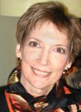
Planning/Notes
Jan Schwartengruber
National Team Co-Organizer
Campaign Updates/ Call Notes
MoveOn Regional Organizer (KS)
EMAIL
janinkansas2@gmail.com

Slide 7

Chat Hosts
Mara Cohen
Chat Host
PDA Mass Criminalization Team Leader
Global Climate Convergence Leader (IL)
EMAIL
marajai51@gmail.com

Slide 8

Chat Hosts
Lisa Oldendorp
Chat Host
MoveOn Regional Organizer (NY)
EMAIL
eslk8r@optonline.net

Slide 9

Call Planning Team
Harriet Heywood
Call Co-Organizer
MoveOn Regional Organizer (FL)
EMAIL
harrietheywood@gmail.com

Slide 10

Call Planning Team
Linda Brewster
Call Planning Team
MoveOn Regional Organizer (WA)
EMAIL
lindabrewster@msn.com

Slide 11


Call Planning Team
Celeste Drake
Call Planning Team
Trade and Globalization Policy Specialist, AFL-CIO
Legislative Actions and Updates
EMAIL
Cdrake@aflcio.org
Twitter
@Cdrakefairtrade

Slide 12
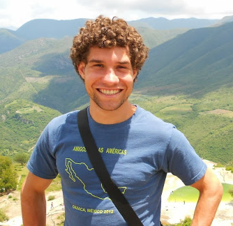
Mackenzie McDonald Wilkins
Climate and Trade Justice Activist
Popular Resistance
Flush the TPP
www.popularresistance.org
www.flushthetpp.org
EMAIL
Mackenzie@popularresistance.org

Slide 13
Updates for Organizing
September 25-28-NYC protests during Pope visit and sustainable development summit (Bayan is also organizing for this)
October 10-17-decentralized actions
October 19-22-protest (blockade?) the TTIP meetings
November 14-18-Possible large action in DC
November 30-December 12 Climate/TPP decentralized actions

Slide 14
Updates for Organizing
Beyond: make TPP, TITP, TiSA an electoral issue that candidates have to talk about. October 10-17-decentralized actions
Always: Build the most powerful intersectional people's movement to stop TPP, TTIP, TiSA and restructure of the global political economy.

Slide 15
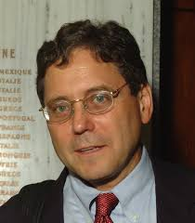
James Love
Knowledge Ecology International
James Love is the Director of Knowledge Ecology International (KEI), an NGO with offices in Washington, DC and Geneva. In 2006, KEI received a MacArthur Award for Creative and Effective Institutions for his work on intellectual property rights. In 2013, Love received the EFF Pioneer Award, for his work on a UN treaty on copyright exceptions for persons who are blind or have other disabilities. Love has been in expert in several compulsory licensing cases, and is an advocate of delinking R&D costs from drug prices.
EMAIL
james.love@keionline.org
BLOG
http://www.keionline.org/blog/jamie

Slide 16
Q&A with Speakers and Guest

Slide 17

Call Planning Team
Adam Weissman
Call Planning Team
TradeJustice/Global Justice for Animals and the Environment
EMAIL
adam@tradejustice.net
Web
www.tradejustice.net

Slide 18
Getting the Most out of Facebook Events
Creating a Facebook Event
Getting Around Facebook Invitation Limitations
Cloning your Event

Slide 19
THANKS
AND WRAP-UP
Upcoming speakers
AND Tentative Topics:
Watch your Email for more details and
registration information:
Labor Call, Currency Manipulation

