Slide 1

National TPP Team Call
Malaysia/Human Trafficking!
Special Guests:
Phil Robertson
Tim Ryan
Emergency Fast Track Bill Update/Actions:
Dr. Margaret Flowers, Popular Resistance
Debra Dion, Citizens Trade Campaign - Florida
Marti Townsend, Sierra Club Hawaii
August 2, 2015
7:30 p.m. Eastern/4:30 p.m. Pacific
Call-in#: 605-562-3140
PIN: 951146#
Back-up#: 559-726-1300

Slide 2
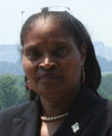

Introduction & Welcome
Andrea Miller, National TPP Team Coordinator
Executive Director
People Demanding Action
Email: andrea@peopledemandingaction.org
    Call Norms
    Meeting Room Functions
Website: http://www.PeopleDemandingAction.org
Download this PowerPoint: http://www.peopledemandingaction.org/downloads/tpp

Slide 3

YOUR TPP CALL HOST TEAM
Tom Hocking
National Call Technical Adviser
National Call Planning Team
MoveOn Regional Organizer, PA
Email: twhocking@gmail.com
●Pre and Post-Call Technical Questions
●Global TPP Team Facebook Page Manager
Website: https://www.facebook.com/groups/GlobalTPPTeam

Slide 4

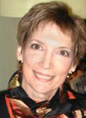
National Call Planning/Notes/Information
Liz Amsden
National Team Co-Organizer
Campaign Updates/Call Notes
MoveOn Council Organizer CA
Email: Lizamsden@hotmail.Com
Jan Swartzendruber
National Call Planning Team
Call Reports/Notes/Resource Vetting
MoveOn Regional Organizer KS
Email: Janinkansas2@gmail.Com

Slide 5


  National TPP Call Chat Hosts
  Mara Cohen
  National Call Planning Team/Chat Host
  PDA Mass Criminalization Team
  Global Climate Convergence Leader, IL
  Email: McMoveOn@gmail.com
  Lisa Oldendorp
  National Call Planning Team/Chat Host
  MoveOn Regional Organizer, NY
  Email: eslsk8r@optonline.net

Slide 6


National Call Planning Team
Harriet Heywood
National Call Team Co-organizer
National Call Program Coordinator
MoveOn Regional Organizer FL
Email: Harrietheywood@gmail.Com
Linda Brewster
National Call Planning Team
MoveOn Regional Organizer WA
Email: LindaJBrewster@msn.com

Slide 7

National Call Planning Team
Adam Weissman
TradeJustice/Global Justice
for Animals and the Environment
Upcoming Events and Actions:
http://tradejustice.net/?page=Events
General Information/Articles: http://tradejustice.net
Email: adam@tradejustice.net

Slide 8
Upcoming TPP Events
Tuesday, August 4:
Rally and Press Conference: No Human Trafficking Coverup for TPP
Wednesday, August 5: National TPP Resistance Call

Slide 9
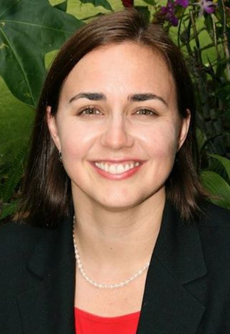
Marti Townsend, Director
Sierra Club – Hawaii Chapter
What happened in Hawaii
Upcoming actions
Facebook: https://www.facebook.com/marti.townsend.9

Slide 10
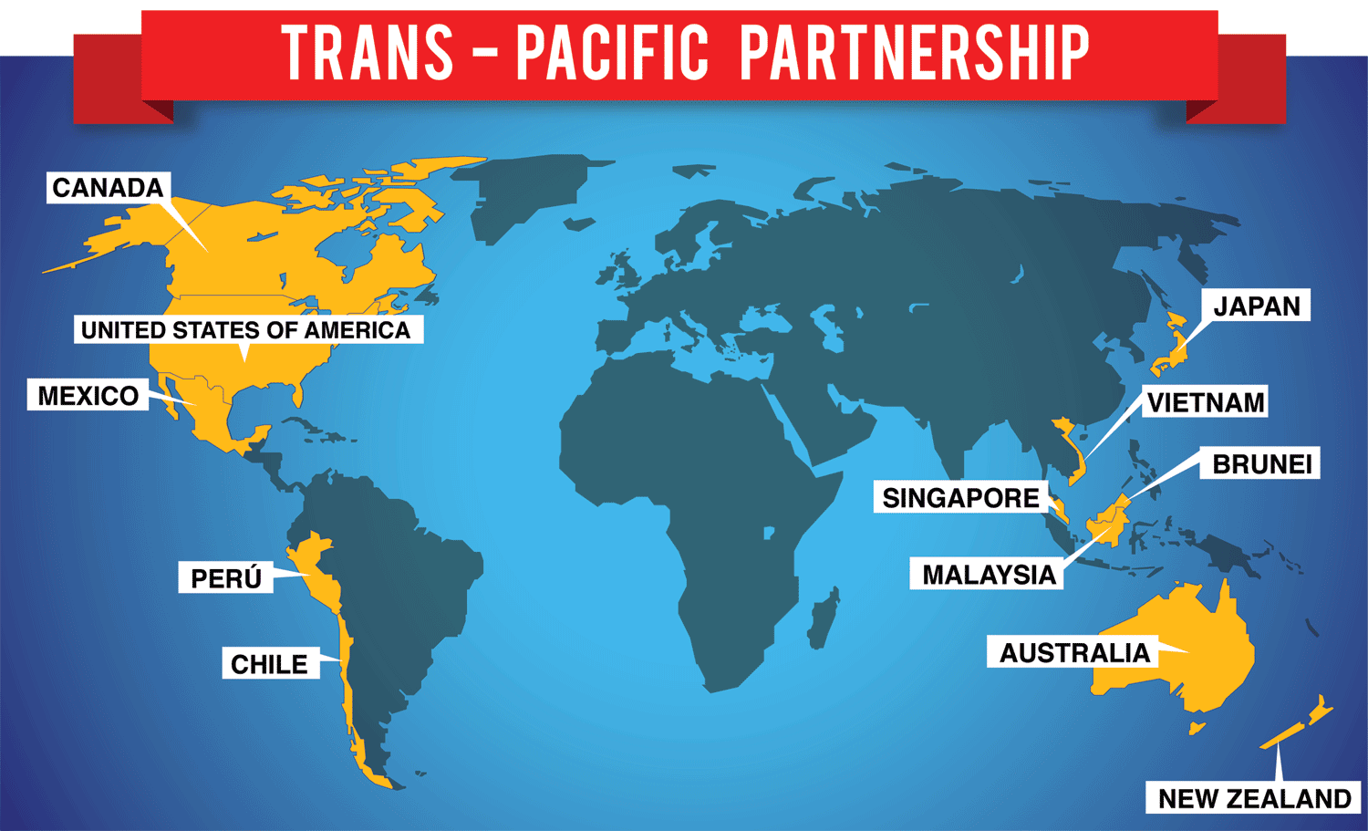
TPP Countries

Slide 11
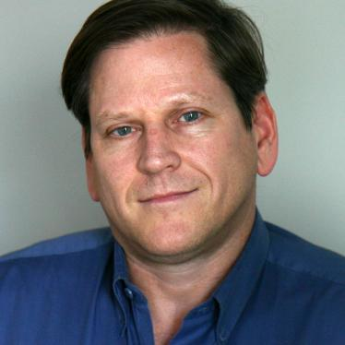

Phil Robertson, Deputy Director
Asia Division, Human Rights Watch
.
Prior to joining Human Rights Watch in 2009, he worked for more than a decade in Southeast Asia on human rights, labor rights, protection of migrant workers, and counter-human trafficking efforts with a variety of non-governmental organizations, international and regional trade union federations, and UN agencies. As program manager of the UN Inter-Agency Project on Human Trafficking (UNIAP), he oversaw the successful negotiation of the first regional inter-governmental agreement on human trafficking in the greater Mekong sub-region.
Website: http://www.hrw.org/
Facebook: https://www.facebook.com/HumanRightsWatch?ref=br_rs

Slide 12
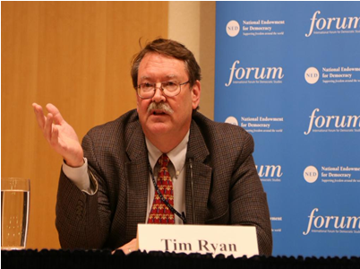
Tim Ryan, Director
Asia regional program director for the American Center for International Labor Solidarity (Solidarity Center), based in Washington, D.C. He also is on the North American Board
for the Global March Against Child Labor.
Website: http://www.solidaritycenter.org
Email: tryan@solidaritycenter.org

Slide 13
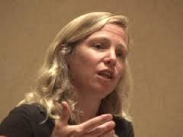
Dr. Margaret Flowers, Activist
and Organizer, Flush the TPP &
Popular Resistance
.
Dr. Flowers is a Maryland pediatrician. After graduation from the University of Maryland School of Medicine in 1990 and completion of pediatric residency at Johns Hopkins Hospital in Baltimore, Flowers worked first as a hospitalist and then in private practice. She left practice in 2007 to advocate full-time for a single payer health care system at both the state and national levels. co-hosts, Clearing the FOG radio which airs on We Act Radio, 1480 AM. Her twitter is @MFlowers8
Email: mdpnhp@gmail.com
Website: www.popularresistance.org and www.flushthetpp.org
Facebook: https://www.facebook.com/margaret.flowers.18?fref=nf

Slide 14
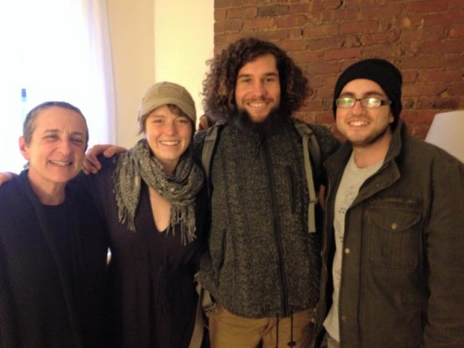
Mackenzie McDonald Wilkins
Climate and Trade Justice Activist
Popular Resistance
Flush the TPP
.
Email: mdpnhp@gmail.com
Website: www.popularresistance.org and www.flushthetpp.org

Slide 15
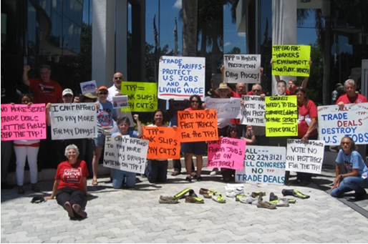
Debra Dion, Florida Director
Citizens Trade Campaign
.
Florida State Director, Citizen's Trade Campaign, Veteran (20 year) AFL-CIO Federal, state and local issues organizer. Instrumental in organizing the 2003 Miami FTAA and strategic organizer around WTO and CAFTA.
Email: dion.deborah@gmail.com

Slide 16
How We Fight TPP
.
Deepen base to work on on-going TPP Campaign in targeted districts
Lay groundwork for TPP to become a political issue in 2016 elections
Let Members of Congress know that their constituents are watching on the TPP

Slide 17
Objectives for overall TPP Campaign moving forward
.
During the August recess:
  Thank you to those members that voted right
  Outreach to broader base -- environmentalists, food groups, Democratic clubs, seniors and students
  Media outreach -- editorial boards and letters-to-the-editor from different groups
  Actions at Members of Congress that voted wrong
  Highlighting the State Department Report of Human Trafficking and Malaysia's upgraded status

Slide 18
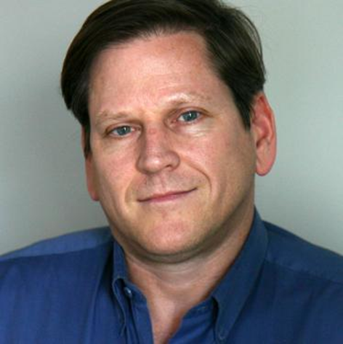
Q & a
with our Guest speakers
Phil Robertson Tim Ryan
Human Rights Watch International Labor Solidarity Center

Slide 19
Comments/Questions
Events and Actions
Strategies/Tactics

Slide 20
THANKS AND WRAP-UP
Andrea Miller, National TPP Team Coordinator
Executive Director
People Demanding Action
Email: andrea@PeopleDemandingAction.org
Upcoming Calls:
August 5: Popular Resistance
August 16: People Demanding Action
Stay tuned for updates

