Slide 1
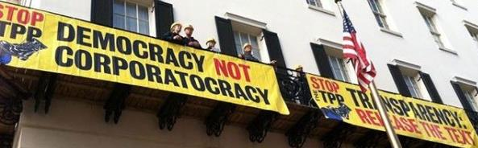
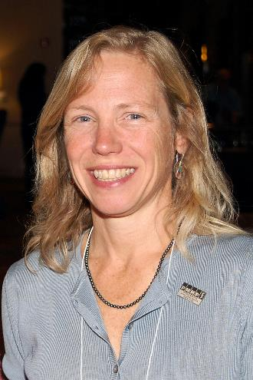
National TPP Team Strategy Call
With Special Guest Speaker
Dr. Margaret Flowers
Popular Resistance
January 25, 2015 7:30 p.m. EST/4:30 PST
Call-In #: 605-562-3140 PIN: 951146

Slide 2
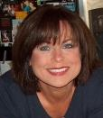
WELCOME!
Elizabeth Warren
MoveOn Regional Organizer
National TPP Team Coordinator
Email: Liz.MoveOn@earthlink.net
• Call structure and norms
• Meeting room functions
Global TPP Team Page: PowerPoint/Report/Tools/Downloads http://on.fb.me/O76Pxm

Slide 3
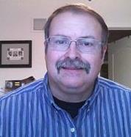

Your TPP call host team:
Tom Hocking – FB Global TPP Page
National Call Team Technical Adviser
MoveOn Regional Organizer, PA
Email: TWHocking@gmail.com
Lisa Oldendorp – Chat Notes
National Call Team Chat Host
MoveOn Regional Organizer, NY
Email: eslsk8r@optonline.net

Slide 4

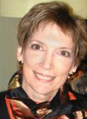
Post-meeting report+
Liz Amsden
National Call Team Co-Organizer
Call Notes/Campaign Updates
MoveOn Council Organizer CA
Email: LizAmsden@hotmail.com
Jan Swartzendruber
National Call Planning Team
Call Notes/Post-Call Report
MoveOn Regional Organizer KS
Email: JanInKansas2@gmail.com

Slide 5


National TPP Call Planning Team
Harriet Heywood
National Call Team Co-Organizer
MoveOn Regional Organizer FL
Email: harrietheywood@gmail.com
Mara Cohen
National Team Core Group
PDA Mass Criminalization Issue Team
Global Climate Convergence Organizer, IL
National TPP Team Chat Host
Email: MCMoveOn@gmail.com

Slide 6

Special Guest Speaker:
Dr. Margaret Flowers
Popular Resistance/FlushTheTPP Campaign
●Campaign Update
●Flush the TPP/Action Map
Ideas for Creative Actions
●GP SOTU/TPP Webinar week before Presidents Day
Email: stopfasttrack@flushthetpp.org
Website: http://www.FlushtheTPP.org http://www.popularresistance.org
Twitter: @FlushTheTPP
Facebook: https://www.facebook.com/FlushTheTPP

Slide 7


National Stop Fast Track Allies
Evan Greer
Fight for the Future
Reportback:
Wyden Rally w/Oregon Fair Trade Coalition
Link to photos: http://imgur.com/a/FOMuS
http://www.stopfasttrack.com
- Congressional Call in Day
- Net Neutrality Update
- Upcoming StopFastTrack/Save the Net Actions
Email: team@fightforthefuture.org EvanGreer@Gmail.com
Website: https://www.fightforthefuture.org

Slide 8
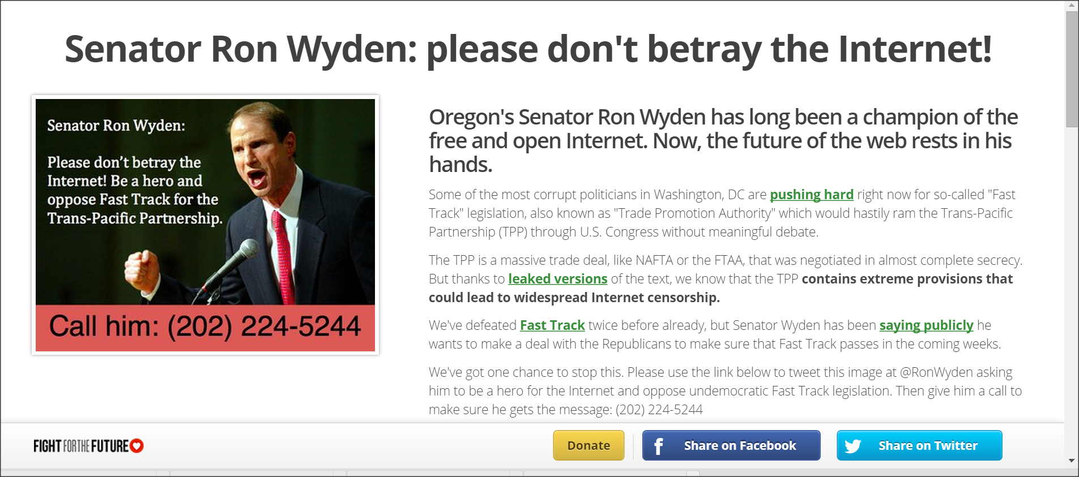

Slide 9

National Stop Fast Track Allies
Adam Weissman
TradeJustice, GJAE
General information/Articles:
http://tradejustice.net
NYC: January 26 EMERGENCY TPP Talks Protest: https://www.facebook.com/events/334278960105604
Email: adam@tradejustice.net
Handouts/Downloads:
General Interest Flier (2 sided, 4 to a page)
Promo Flier Focusing on TPP Impacts on Communities of Color

Slide 10
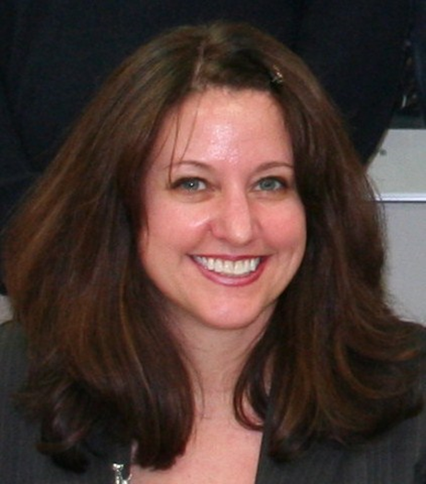
National Call Planning Team
Stop Fast Track Allies
Celeste Drake
Trade and Globalization
Policy Specialist, AFL-CIO
●New messaging (jobs) plus tools for writing Congress
●Flyers/handouts, talking points and more!
Twitter: @CDrakeFairTrade
Email: CDrake@aflcio.org

Slide 11
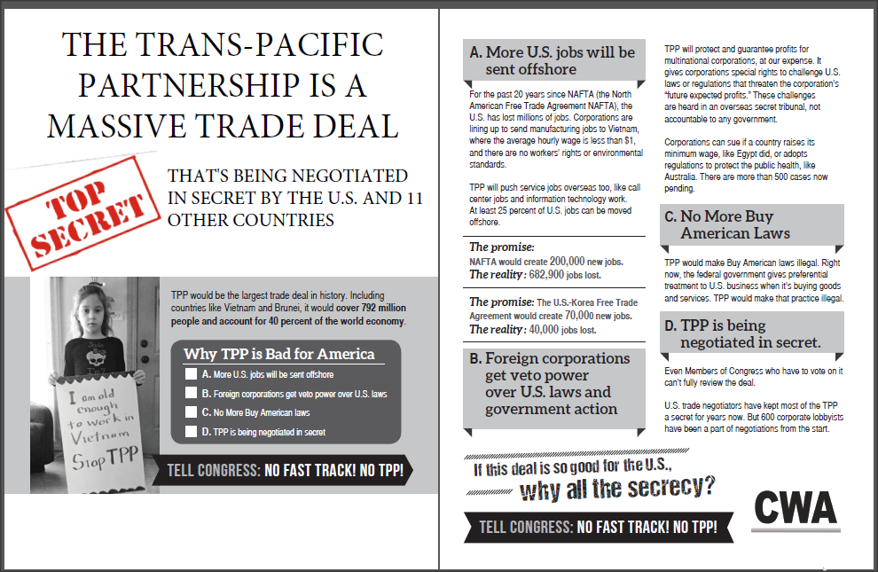
Explaining the TPP Flyer

Slide 12
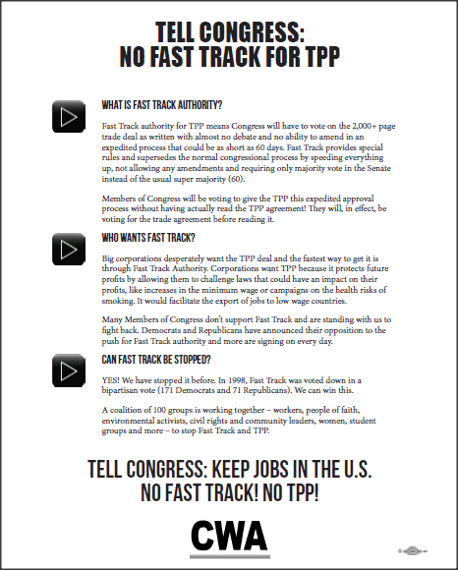
No Fast Track Flyer / Handout for Rallies and Events

Slide 13
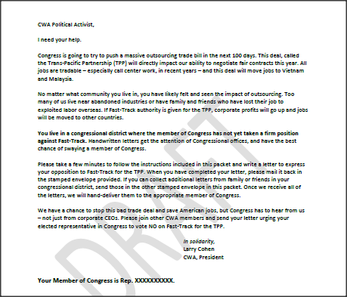
Sample “Contact Congress” recruitment letter from CWA President Larry Cohen

Slide 14
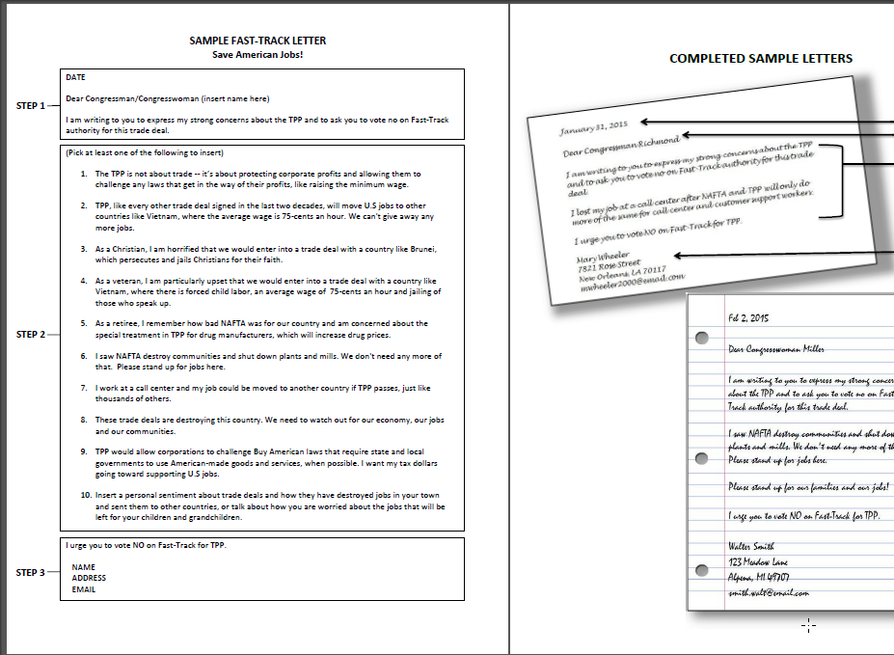
Sample
Fast Track
Letter to send
Congress

Slide 15
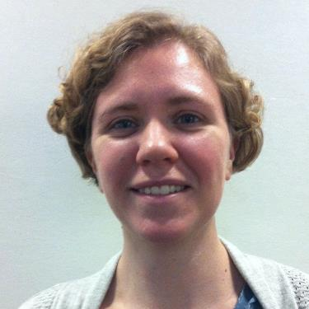

National Stop Fast Track Allies
Kathryn Johnson
Field Organizer, Public Citizen Global Trade Watch
Stop Fast Track Update:
● The State of the Union address
● February Congressional Recess: how we can take advantage of it
● Communications theme for next week: TPP = NAFTA+
● Social Media initiatives around TPP and Fast Track
Email: kjohnson@citizen.org
Website: http://www.tradewatch.org
TPP Resources: http://www.exposethetpp.org
Facebook: www.facebook.com/GlobalTradeWatch
Our blog: http://www.EyesOnTrade.org

Slide 16
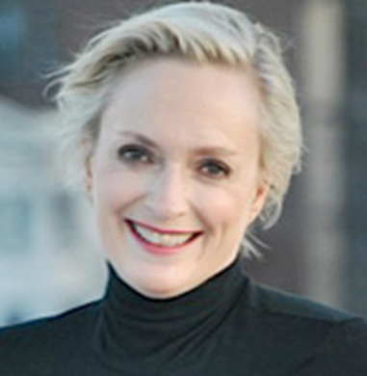
National Call Planning Team
Emilianne Slaydon
Director, Social Media
@TPP Media March
Was called away today,
but will be running Tuesday’s storm
  TPP Tuesday Twitter Storms
6 p.m. PST / 9 p.m. EST
Email: eslaydon@mac.com
TPP/TTIP Tuesday Tweets
January 27: http://www.tiny.cc/TPPMediaMarch

Slide 17


Slide 18

National Call Planning Team
Stop Fast Track Allies
Andrea Miller
Executive Director People Demanding Action
Co-Executive Director Progressive Democrats of America
Email: amiller@pdamerica.org
Websites:
http://www.PeopleDemandingAction.org
http://www.PDAmerica.org/tpp
Fast Track Letter to the Editor Tool: http://salsa.wiredforchange.com/o/6405/c/10113/letter/?letter_KEY=865

Slide 19
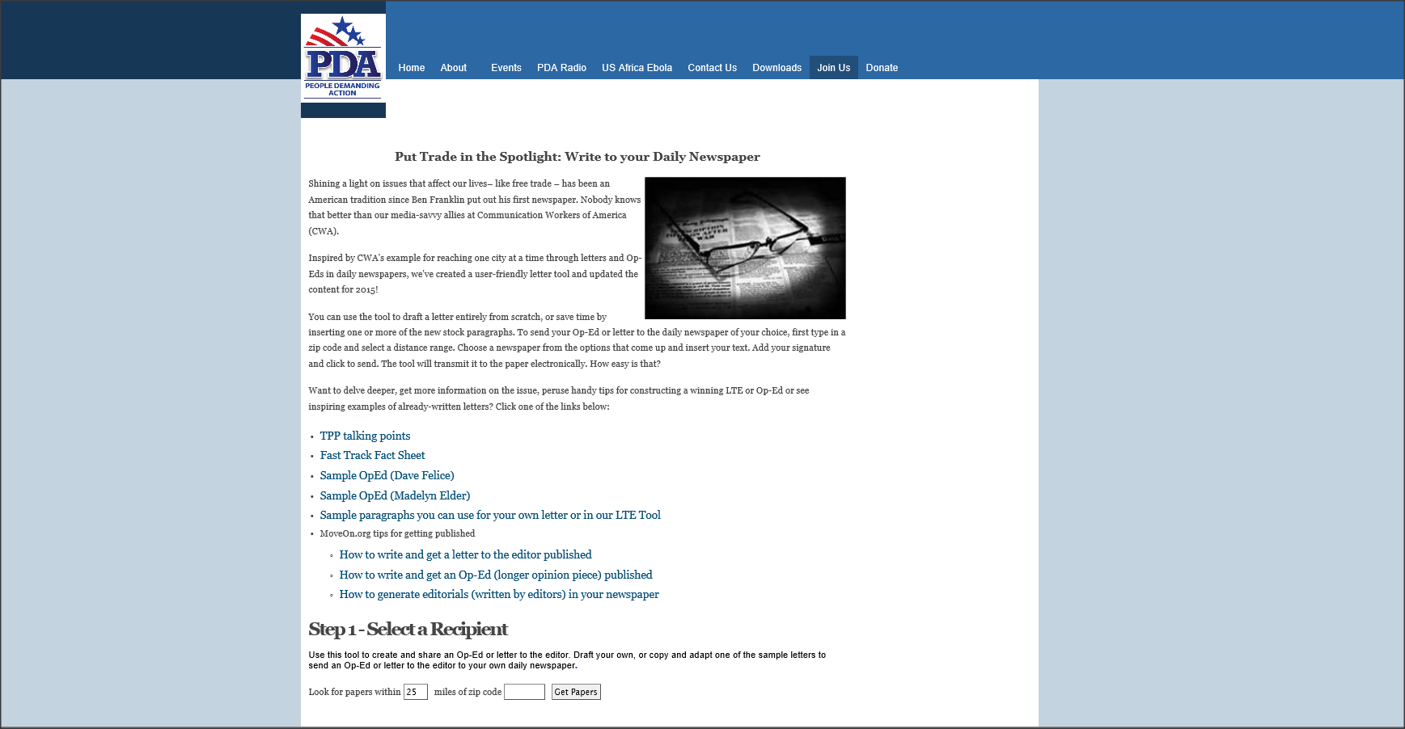
Letter to the Editor Tool includes:
click to paste stock content,
writing samples,
and helpful links
to walk you through how to craft a compelling Letter
to the Editor or
Op-Ed,
and get it published!

Slide 20
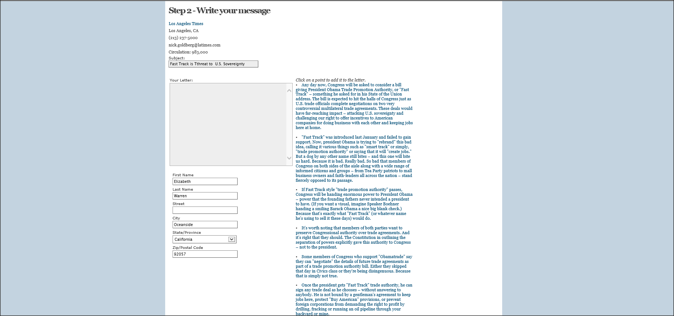
Search for your desired newspaper by zip code.
When the tool opens, type directly into the text box to draft your letter from scratch,
click on any of the copy blocks to insert one or more stock paragraphs, or combine the two!
When you’re finished composing, add your contact information
and click to send your letter electronically!

Slide 21
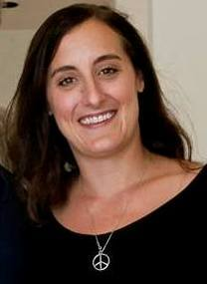
National Stop Fast Track Allies
Kali Gochmanosky
Citizens Trade Campaign
Southern California
Email: kali@citizenstrade.org
SoCal Congressional Targets and Actions
-Update: Which Congress members
are with us and which ones are not
-Update: Upcoming So Cal actions

Slide 22
Upcoming Speakers:
February 8:
Dave Johnson
Campaign for America’s Future
TBA:
Robert Kuttner
Economic Policy Institute
Thanks and Wrap-Up

