Slide 1
Welcome
California Clean Climate Coalition Kick-off
Sunday , August 16th 2015

Slide 2

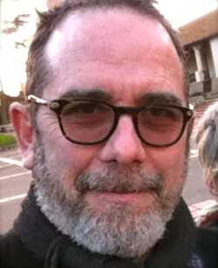
California Clean Climate Coalition
Your hosts
Russell Greene R.L. Miller
Board President, Co-Founder,
People Demanding Action Climate Hawks Vote
Vice Chair, Legislation Chair
CDP, Environmental Caucus CDP, Environmental Caucus

Slide 3

Andrea Miller
Executive Director,
People Demanding Action

Slide 4
Technical Stuff
RSVP for the call https://actionnetwork.org/events/ca-climate-leadership-call
DIAL IN : 605 562 3140 pin 698570#
VIEW THE WEBINARhttp://login.meetcheap.com/conference,87610294
JOIN THE DISCUSSION BOARD
REVIEW THE LEGISLATION: http://focus.senate.ca.gov/climate

Slide 5
California Clean Climate Coalition
-What are the CCCC’s objectives?
-Timeline
-Tonight’s Agenda
-Bill McKibben on California’s Climate Leadership
-Senate President pro tem Kevin de León on the legislation and the process
-How we will take action

Slide 6
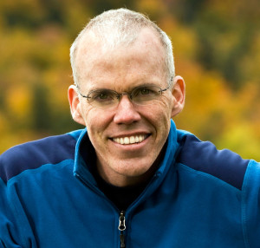
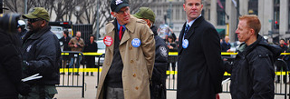
Bill McKibben
Author, Educator, Environmentalist
Founder, 350.org
billmckibben.com

Slide 7
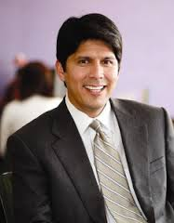

Kevin de León
California Senate President Pro Tem

Slide 8
Key Legislation
-SB 185 Senator Kevin de León
Public retirement systems: public divestiture of thermal coal
companies (Status: Assembly- Appropriations)
-SB 32 Senator Fran Pavley
-California Global Warming Solutions Act of 2006: Emissions
Limit (Status: Assembly- Appropriations)
-SB 350 Senators Kevin de León & Mark Leno
-Clean Energy and Pollution Reduction Act
(Status: Assembly- Appropriations)

Slide 9
Full Climate Bill Package
SB 185 (De León) Investing with Values and Responsibility
SB 32 (Pavley) CA Global Warming Solutions Act of 2006: emissions limit
SB 350 (De León & Leno) Golden State Standards
SB 9 (Beall) Transit and Intercity Rail Capital Program
SB 64 (Liu) California Transportation Plan
SB 189 (Hueso) Maximizing Jobs and Economic Growth

Slide 10
Full Climate Bill Package
SB 246 (Wieckowski) Climate Adaptation
SB 367 (Wolk) Agriculture Climate Benefits Act
SB 379 (Jackson) Climate Adaptation
SB 398 (Leyva) Green Assistance Program
SB 758 (Block) Atmospheric Rivers
SB 788 (McGuire & Jackson) California Coastal Protection Act of 2015

Slide 11
Timeline
POLITICAL CALCULUS
CDP Exec. Board endorsed SB 350 SB 32, SB 185, SB 788
Ca. State Assembly Session Opens Tomorrow
Appropriations Committee – Vote on Wed.
Then to the floor
That’s when they must hear from us……

Slide 12
Committee on Appropriations
Democrats
Republicans
Jimmy Gomez, Chair
Richard Bloom
Rob Bonta
Ian Charles Calderon
Tom Daly
Susan Talamantes Eggman
Eduardo Garcia
Chris Holden
Bill Quirk
Anthony Rendon
Shirley Weber
Jim Wood
Frank Bigelow, Vice Chair
Ling-Ling Chang
Brian Jones
Donald P. Wagner
James Gallagher

Slide 13
Next Steps
Petition to Governor Jerry Brown
Assembly District Office Visits
Assembly Office Phone Call and Letter Writing Campaigns
Petitions to key Assembly Members
Coalition Calls Each Sunday until the vote is complete
  Same number
  Same Webinar Room
RSVP -Invite Friends – Spread the word

Slide 14


Slide 15
